Slide 1

An Integrated Architecture for Maintaining Security in Cloud Computing Based on Blockchain
This paper introduces a novel approach, integrating cloud computing with blockchain technology to ensure data integrity, particularly for homomorphic encryption schemes. Our proposed architecture leverages Byzantine Fault Tolerance to create a distributed network of processing Cloud Service Providers (CSPs), tailored to meet specific client requirements. To ensure verification, master hash values are securely preserved within either the Bitcoin or Ethereum blockchain networks.

Slide 2
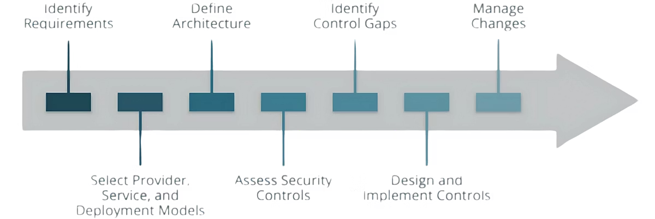
Cloud Computing Security Threats
Data Breaches
Encryption and Key Management
Data breaches are a primary concern, undermining the validity and trust of cloud-based services. They can result from targeted attacks, human error, implementation vulnerabilities, or inadequate security procedures.
Encryption and key vulnerabilities or data storage cryptography vulnerabilities could lead to data breaches. The absence of appropriate encryption algorithms and poor key management can contribute to encryption failures.

Slide 3

Homomorphic Encryption (HE)
Key Generation
Data owner creates the public-key pair (a public key puk and a private key prk).
Encryption
Applying the encryption algorithm onto the data C = Encpuk (P) before sending it to the cloud server.
Evaluation
Cloud server performs the requested calculation on the encrypted data.
Decryption
Client is able to process the decryption function, Dec, to recover the plaintext.

Slide 4





Blockchain Technology (BC)
Secure
Distributed
Validated
Tamper Resistant
Implementing BC techniques in cloud scenarios have attracted considerable attention. BC technology consists of distributed digital blocks bound to each other based on cryptographic principles. Each block contains a cryptographic hash of the previous block, a timestamp and transaction data.

Slide 5


Bitcoin and Ethereum
Bitcoin
Ethereum
BTCs are obtained as rewards via mining and can be transferred between Bitcoin accounts. Each transfer is recorded in a transaction that will be stored in a block on the BC. All participating nodes store the same copy of the Bitcoin BC.
Ethereum is not just a cryptocurrency network but rather a network of independent computers that function together as one supercomputer. It is flexible in allowing the establishment of transactions over either permissioned or permissionless network.

Slide 6

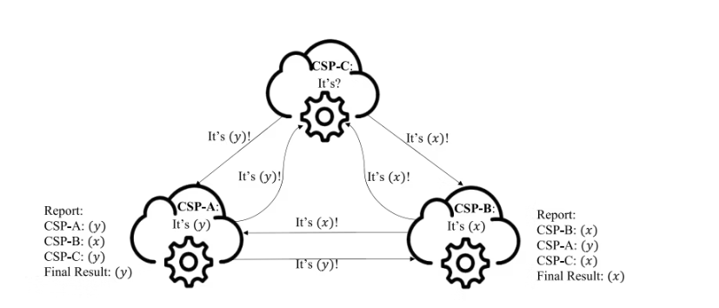



Proposed Verification Scheme
Multi-CSPs
Client hires multiple CSPs to perform computations and produce a master hash for their database.
BC-based application
Creates new blocks containing master hashes as transactions and returns the block header to CSP.
Client
Performs verification by comparing master hash values from each CSP based on the received block header information.

Slide 7
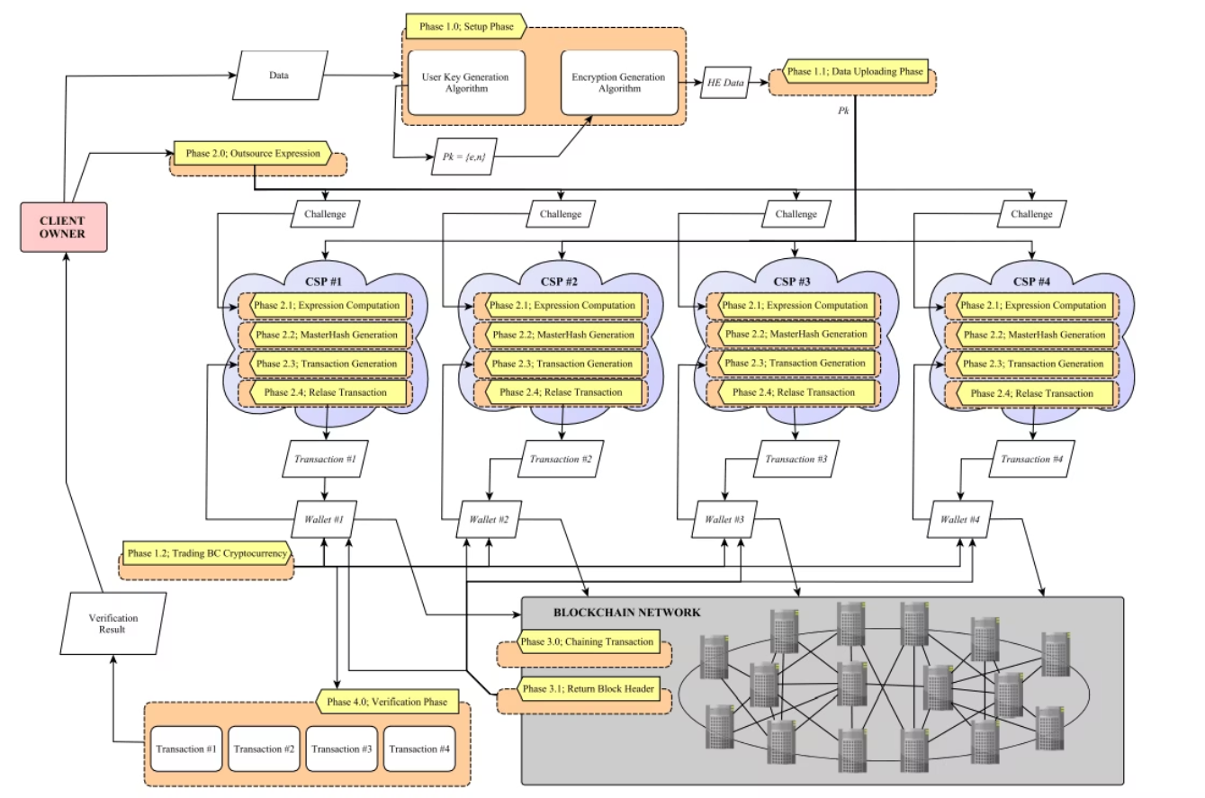
Flow Chart

Slide 8



CSP - Computation Phase
Calculate Hash
Calculate the master hash value of its database by applying SHA-2.
Save Hash
The CSP saves the master hash in a transaction log.
Forward to Mining Pool
Forwards it to the mining pool to be stored in the BC network.
To perform verification in the CSP environment, we adopt certain BC's BFT consensus features and put them into practice. The proposed work will also rely on hash functions as well as the properties of the distributed ledger. The concept of utilising many different nodes in creating a new block is adopted by the proposal.

Slide 9


Blockchain - Master Hash Phase
Bitcoin
Ethereum
Setting up BTC wallet, preparing raw transaction, signing transaction and broadcasting to the Bitcoin network.
1
Setting up ETH wallet, preparing raw transaction and broadcasting to Ethereum network.
2
To store the master hash values, we consider two popular cryptocurrencies, Bitcoin and Ethereum. Despite having different architectures and features, the flow of currency from the CSP's wallet to the network is the same for both.

Slide 10

Client Phase - Verification
Bitcoin Verification
Ethereum Verification
Verification of master hash values is simple due to the multisig wallets. The client has the ability to read the stored data value inside the transaction.
Verification using Ethereum will vary depending on the type of account being used. For EOAs, each CSP is required to send the block header to the client for each transaction.
After storing the master hash in the BC, it is now the client's role to verify that the values sent by all CSPs are identical. Verifications differ according to the different platforms used in this research, so that this process will be discussed separately with respect to the Bitcoin and Ethereum models.

Slide 11

Conclusion
This paper addresses data breaches in cloud computing. We propose a solution that uses homomorphic encryption to protect data confidentiality and privacy during cloud computations.
To ensure data integrity and detect tampering, we introduce a distributed network of cloud providers with Byzantine Fault Tolerance consensus.

